Slide 1
Web Development

Slide 2
Web Development
Developing a web site for the Internet (World Wide Web) or an intranet (a private network)
web engineering
web design
web content development
e-commerce
Usually refers to the main non-design aspects of building web sites: writing markup and coding

Slide 3
Web application
or web app is a client–server software application in which the client (or user interface) runs in a web browser
webmail
online retail sales
School management system
Online Banking
Social network
have similar functionality to a desktop software application, or to a mobile app

Slide 4
Why are we using Web App?
Difference between Web App and Website?
Dynamic vs Static
Examples
Why not Mobile App?
Cross Platform
App deployment and install
Examples
Notes:
Difference between Web App and Website:
Dynamic vs Static
Examples of Web Apps
Examples of Websites
Why not Mobile App?
Examples of Mobile Apps
Cross Platform

Slide 5
Web Development Technologies
HTML
CSS
JavaScript
Define content of the web pages
Specify the layout and aesthetics of web pages
Program the behavior of web pages
LAYOUT, AESTHETICS
CONTENT
BEHAVIOR

Slide 6
Web Development
Bootstrap
HTML
CSS
JavaScript

Slide 7

Server-side Technologies

Slide 8
End.

Slide 9

HTML
Defining the Contents of the Web Page
Layout
Basics
Tables
Text
Images
Links
HTML and CSS
Lists

Slide 10
Basics
Can be edited in any text editor
Built In: Notepad (PC), TextEdit (Mac)
Download: VS Code
Save as: index.html / index.htm
These are the same – no difference at all
Layout
Basics
Tables
Text
Images
Links
HTML and CSS
Lists
Notes:
Text Editors include vs code - works on everything - linux mac windows

Slide 11
Basics
Hyper Text Markup Language
Markup Language – a set of markup tags
HTML – HTML Tags
Each tag describes a different document content
Layout
Basics
Tables
Text
Images
Links
HTML and CSS
Lists
Notes:
Hyper Text Markup Language
Markup Language – is a set of markup tags
Example of other markup languages – e.g. Markdown
HTML – HTML Tags
Each tag describes a different document content
DOCTYPE surrounds the entire page structure (shown) – displays a document correctly – not case sensitive
Examples: html, head, title, body, h1, p

Slide 12
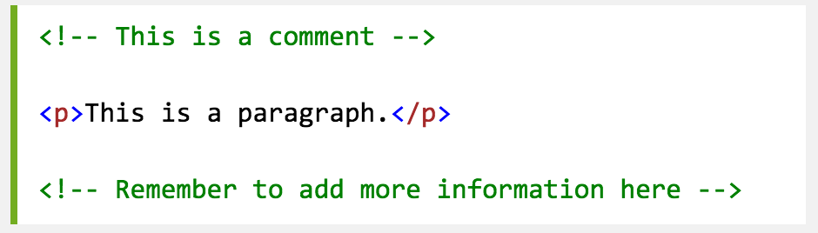
Basics
Commenting
Layout
Basics
Tables
Text
Images
Links
HTML and CSS
Lists
Notes:
Hyper Text Markup Language
Markup Language – is a set of markup tags
Example of other markup languages – e.g. Markdown
HTML – HTML Tags
Each tag describes a different document content
DOCTYPE surrounds the entire page structure (shown) – displays a document correctly – not case sensitive
Examples: html, head, title, body, h1, p

Slide 13
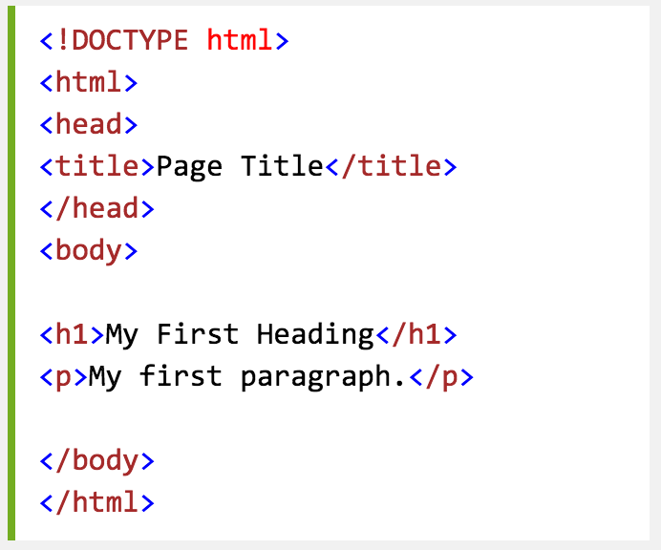
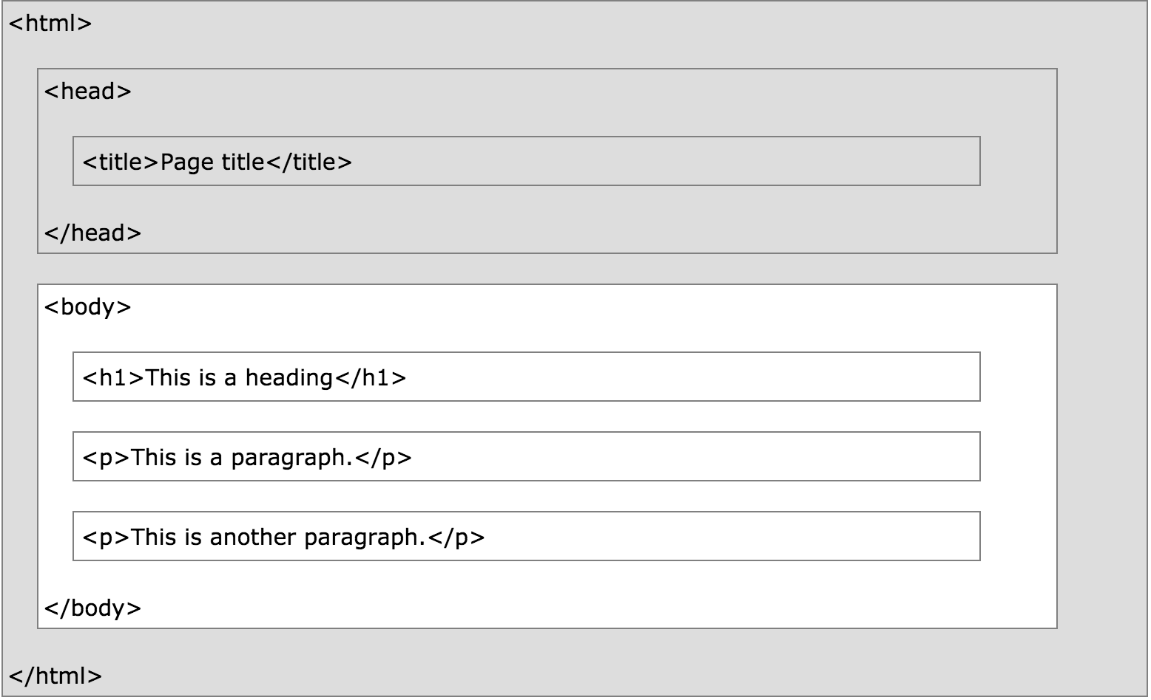
Layout
Layout
Basics
Tables
Text
Images
Links
HTML and CSS
Lists
Notes:
Note: <title> tag puts it where ‘index.htm’ is.
Remember to do the end tag!
DOCTYPE surrounds the entire page structure (shown) – displays a document correctly – not case sensitive
Examples: html, head, title, body, h1, p

Slide 14
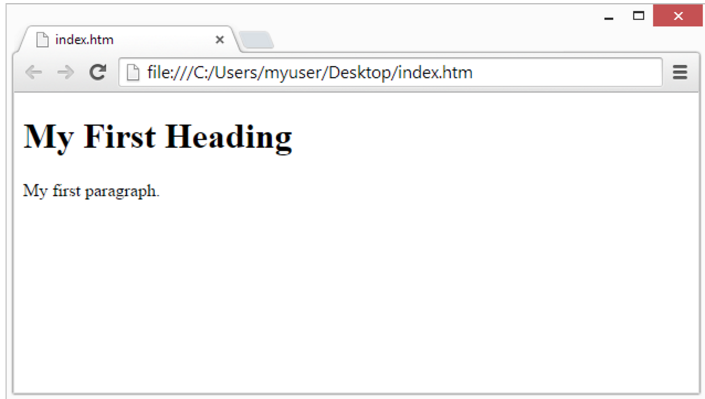
Layout
Layout
Basics
Tables
Text
Images
Links
HTML and CSS
Lists
Notes:
Note: <title> tag puts it where ‘index.htm’ is.
Remember to do the end tag!

Slide 15
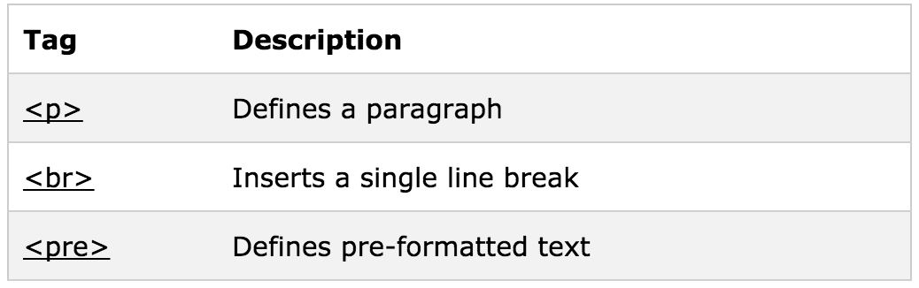
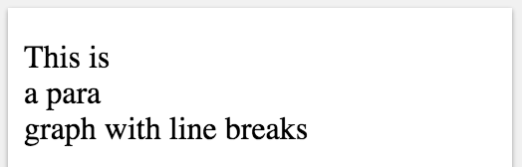
Text
Line Breaks
Layout
Basics
Tables
Text
Images
Links
HTML and CSS
Lists
Notes:
Line Breaks: Use line breaks if you want to have start on a new line – without making a new paragraph each time

Slide 16
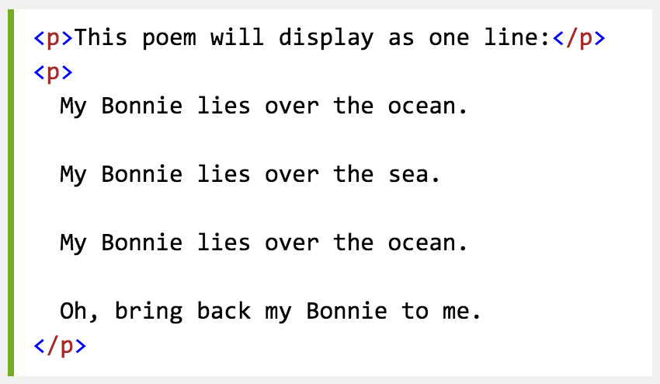
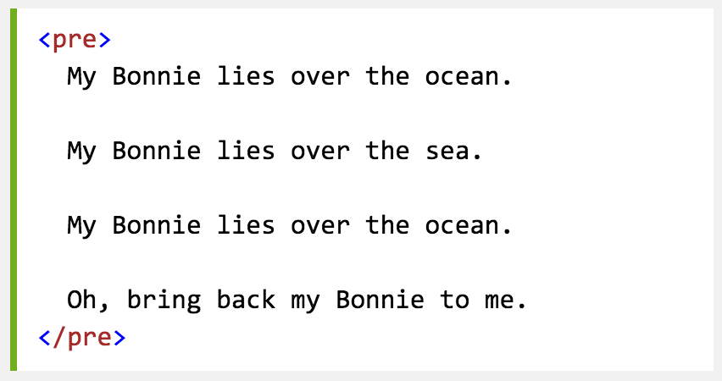
Text
Paragraph
Preformatted
Layout
Basics
Tables
Text
Images
Links
HTML and CSS
Lists

Slide 17
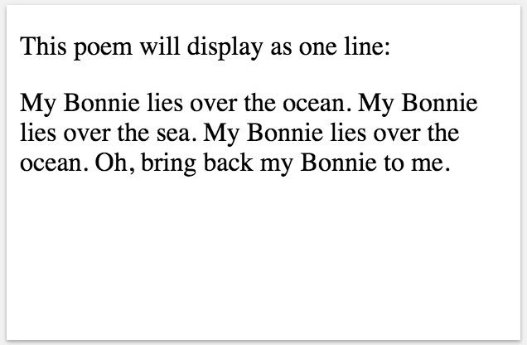
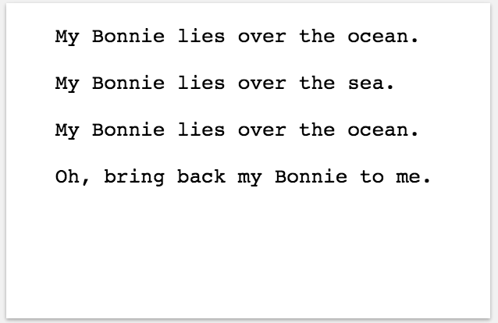
Text
Paragraph
Preformatted
Layout
Basics
Tables
Text
Images
Links
HTML and CSS
Lists

Slide 18
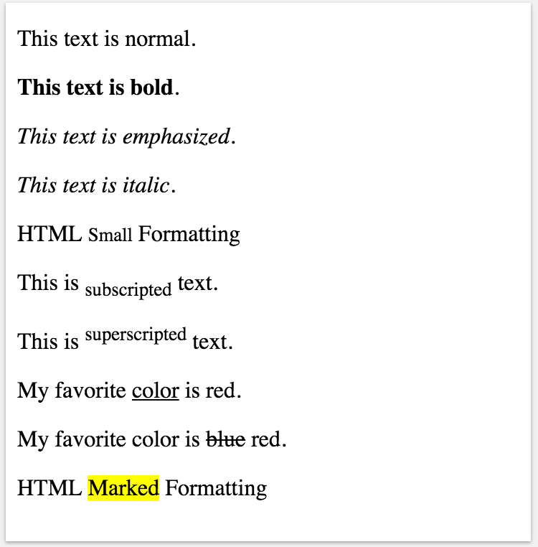
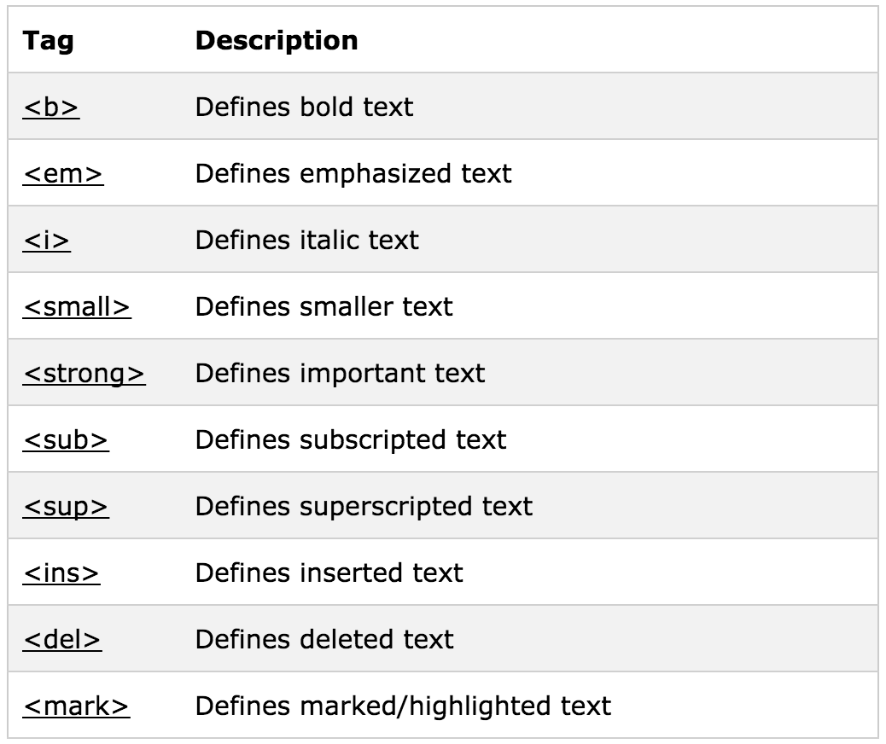
Text
Layout
Basics
Tables
Text
Images
Links
HTML and CSS
Lists
Notes:
Line Breaks: Use line breaks if you want to have start on a new line – without making a new paragraph each time

Slide 19
Links
HTML link = “hyperlink”
Text or image you can click on
Jumps to another document (another .html or .htm)
Layout
Basics
Tables
Text
Images
Links
HTML and CSS
Lists

Slide 20

Links
Links are defined with the <a> tag
Where you want your link to go using href
Link text: visible part
Layout
Basics
Tables
Text
Images
Links
HTML and CSS
Lists
Notes:
Talk about how you insert an image tag into the <a> HERE </a> to make an image linkable.

Slide 21
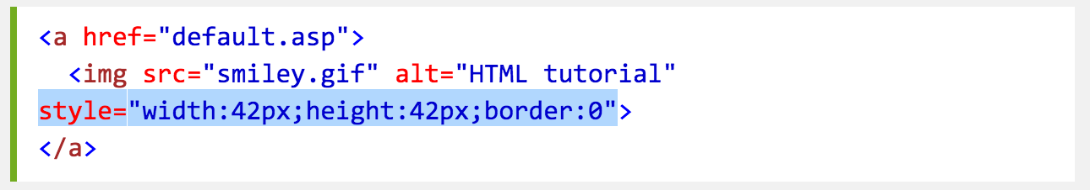
Links
Linking Text
Linking an Image
Layout
Basics
Tables
Text
Images
Links
HTML and CSS
Lists
Notes:
Talk about how you insert an image tag into the <a> HERE </a> to make an image linkable.
The style = if your image isn’t the size you want.
Images coming up soon

Slide 22
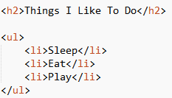
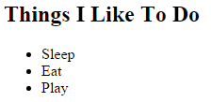
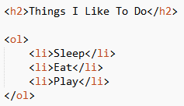
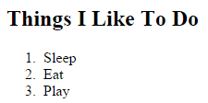
Lists
Ordered – Numbered List <ol> tag
Unordered – bullet points <ul> tag
Layout
Basics
Tables
Text
Images
Links
HTML and CSS
Lists

Slide 23
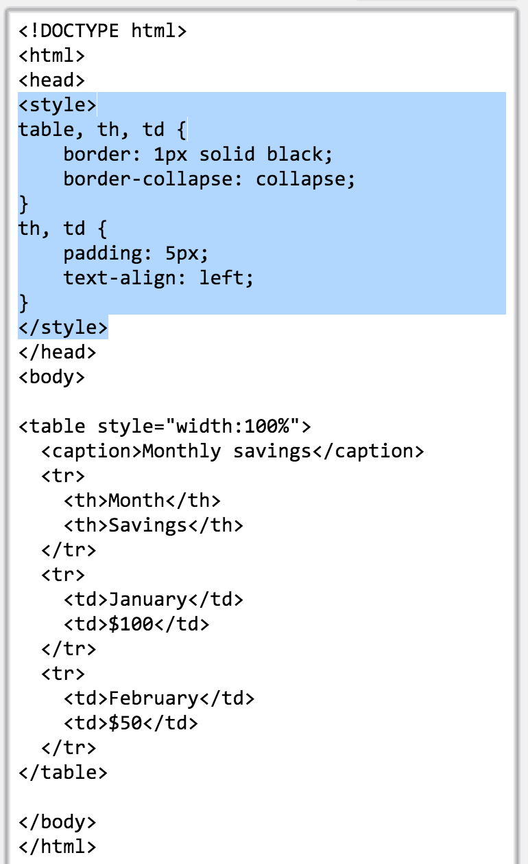
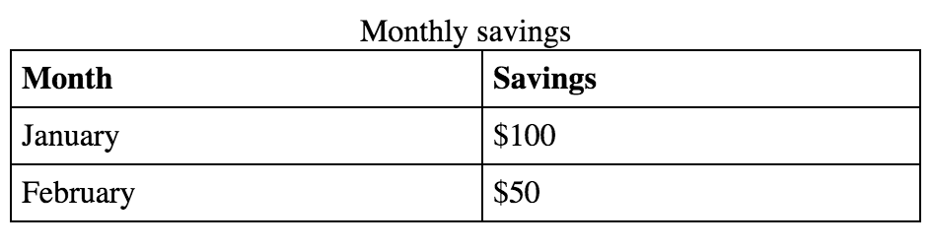
Tables
Tables <table> tag
Rows <tr> tag
Columns <td> tag
Headings <th> tag
Layout
Basics
Tables
Text
Images
Links
HTML and CSS
Lists
Notes:
Columns – table data.

Slide 24
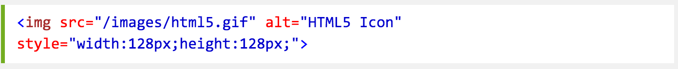
Images
Adding from local / online source
Alternative Descriptions alt
Layout
Basics
Tables
Text
Images
Links
HTML and CSS
Lists

Slide 25
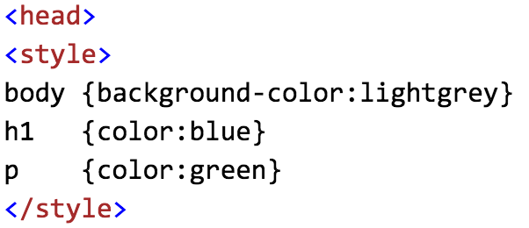
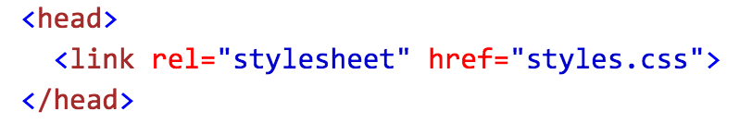
HTML and CSS
Inline – style attribute in HTML elements
Internal – using <style> element in HTML <head> section
External – using 1+ external CSS files
Layout
Basics
Tables
Text
Images
Links
HTML and CSS
Lists

Slide 26

CSS
Specifying the layout of web pages
Basics
Link States
Fonts
Selectors
Background
Box Model

Slide 27
Basics
Cascading Style Sheet
Describes the presentation of an HTML document
CSS saves a lot of work. It can control the layout of multiple web pages all at once
Save as: style.css
Basics
Link States
Fonts
Selectors
Background
Box Model
Notes:
Text Editors include vs code - works on everything - linux mac windows

Slide 28
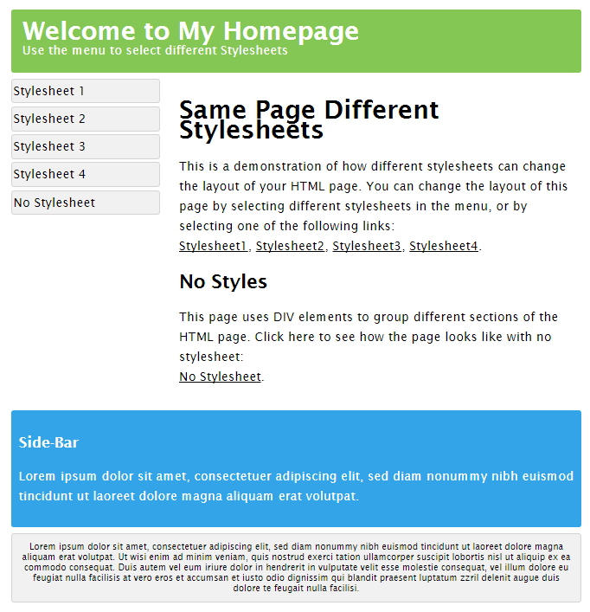
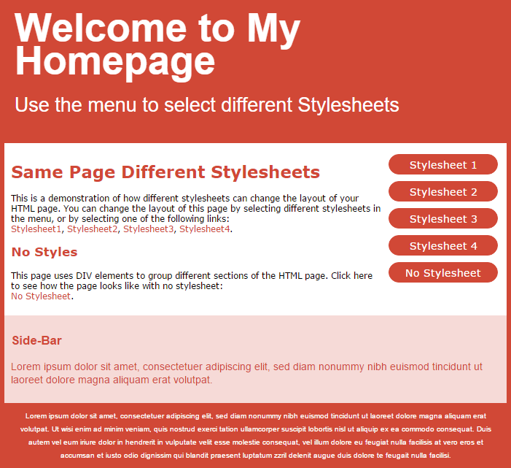
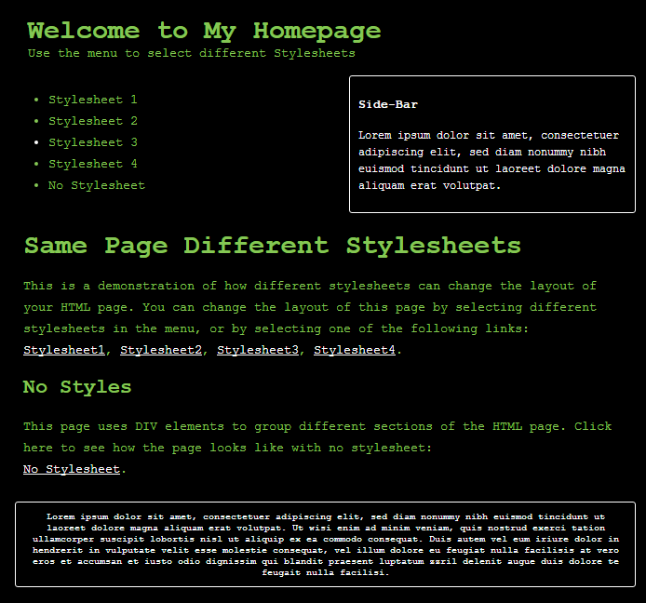
Same page different stylesheets
Basics
Link States
Fonts
Selectors
Background
Box Model
All different external .css files!
Notes:
CSS is used to define styles for your web pages, including the design, layout and variations in display for different devices and screen sizes.
Style definitions saved in exte

Slide 29
Yellow Header
h1 { color: yellow; font-size: 60px; }
Hello World! → Hello World!
Basics
Link States
Fonts
Selectors
Background
Box Model

Slide 30
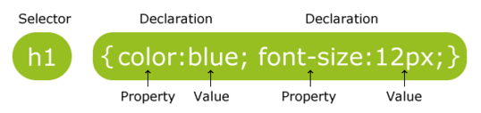
Syntax
Selector – points to the HTML element you want to style
Declaration block – contains 1+ decelerations separated by ;
Declaration – Property name : Value
/* This is a single-line comment */
Basics
Link States
Fonts
Selectors
Background
Box Model

Slide 31
Selectors
Element – selects elements based on the element name
<p>Hello</p>
p { color: red; }
ID – uses the id attribute of an HTML element to select an element
<p id=“para1”>Hello</p>
#para1 { color: red; }
Class - selects elements with a specific class attribute
<p class=“special”>Hello</p>
.special { color: red; }
Basics
Link States
Fonts
Selectors
Background
Box Model
Notes:
Reminder; IDs are unique while classes are not. So you can change multiple elements with classes/element

Slide 32
Selectors
Class – specify elements that should be effected by a class
<p class=“special”>Hello</p>
p.special { color: red; }
Grouping – same style definitions , separated with a comma
h1, h2, p { color: red;}
Css declarations at the bottom take precedence
p { color: yellow; font-size;60px; }
p { color: red; }
______
Hello!
Hello!
Basics
Link States
Fonts
Selectors
Background
Box Model

Slide 33
Font
Font Style – specify text style normal, italic, oblique
font-style: italic;
Font Size – size of the text
font-size: 40px; /* absolute in pixels */
font-size: 2.5em; /* relative 1em is equal to current font size, default text size in browsers is 16px “
Basics
Link States
Fonts
Selectors
Background
Box Model

Slide 34
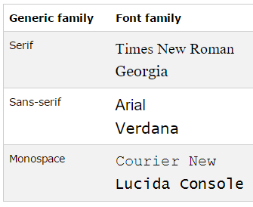
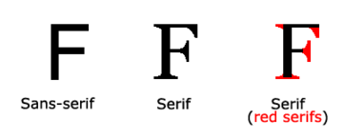
Fonts – font family – font of text
Generic family – group of font with a similar look
Font family – specific font family
p { font-family: "Times New Roman", Times, serif; }
Multiple font names are used so that if a browser doesn’t recognize the first font, tries the next …
Basics
Link States
Fonts
Selectors
Background
Box Model

Slide 35
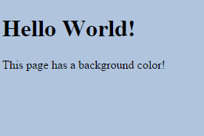
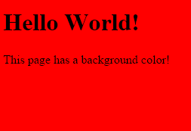
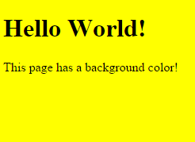
Background
Specifies the background effects of an element
Specifies the color of the element – HEX, RGB, name
background-color: #b0c4de;
background-color: rgb(255,0,0);
background-color: yellow;
Basics
Link States
Fonts
Selectors
Background
Box Model

Slide 36
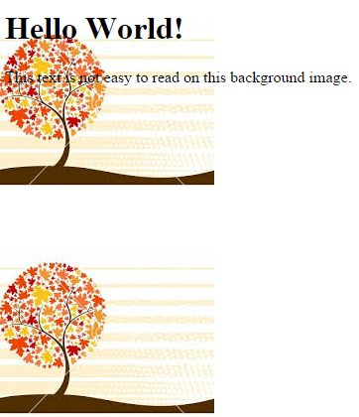
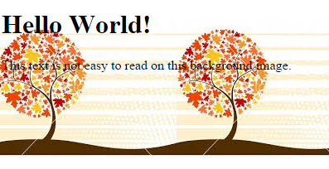
Background
Specifies an image to use as the background – default repeated
background-image: url(“img_tree.png");
Repeat horizontally/vertically
background-repeat: repeat-y; /* repeat vertically */
Basics
Link States
Fonts
Selectors
Background
Box Model

Slide 37



Background
Specifies the size of the background
background-size: 450px 450px;
background-size: cover;
background-size: contain;
Can set all the background properties in 1 declaration
background: #ffffff url("img_tree.png") no-repeat right top;
Basics
Link States
Fonts
Selectors
Background
Box Model

Slide 38
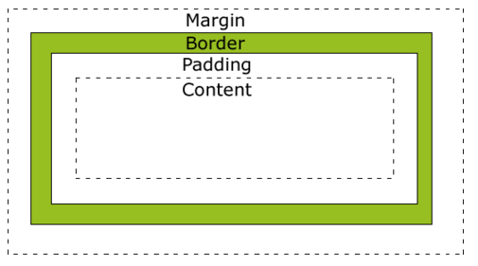
Box Model
All HTML elements can be considered as boxes
Box model – a box that wraps around every HTML element
Content – content of the box – where text + images appear
Padding – clears an area around content – transparent
Border – goes around padding + content – can change style
Margin – clears an area around the border – transparent
Basics
Link States
Fonts
Selectors
Background
Box Model

Slide 39
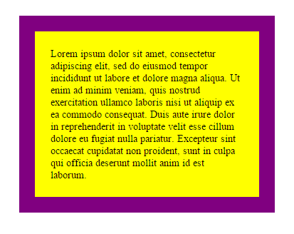
Box Model Example
div { width: 300px; padding: 25px; border: 25px solid purple; margin: 25px; }
padding-top: 25px
padding-right: 30px ….
Basics
Link States
Fonts
Selectors
Background
Box Model
Notes:
Can do padding for all sides or individual sides by different declarations
This can be done for all other elements in box model – ie border: border-style: solid, border-width: 5px;

Slide 40
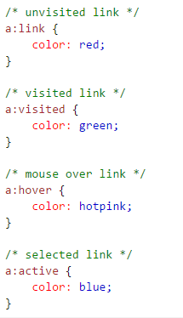
Link States
Links can be styled differently depending on what state they are in
a:hover MUST come after a:link and a:visited
a:active MUST come after a:hover
Basics
Link States
Fonts
Selectors
Background
Box Model

Slide 41
JavaScript
Program the behavior of web pages

Slide 42
JavaScript
One of the most popular programming languages in the world
Essential component of websites and web applications
All modern browsers support JavaScript
JavaScript is also used in non- web based environments like .pdf
It is not Java!
“JavaScript is to Java as Car is to Carpet”

Slide 43
Showing Output
Different ways to show output
alert(“Hello World”)
document.write(“Hello World”)
document.getElementById("demo").innerHTML = “Hello World”
console.log(“Hello World”)

Slide 44
Functions
function name(parameter1, parameter2) { code to be executed }
function addNumbers(p1, p2) { return p1 + p2; }
Notes:
A JavaScript function is a block of code designed to perform a particular task.

Slide 45
Calling Functions
Functions can be called when:
-An event occurs
<button onclick='getElementById("demo").innerHTML=Date()’>
-Called by another JavaScript code
function addNumbers(){
return getNumberOne() + getNumberTwo();
}

Slide 46
Common HTML Events
Event | Description
onchange | An HTML element has been changed
onclick | The user clicks an HTML element
onmouseover | The user moves the mouse over an HTML element
onmouseout | The user moves the mouse away from an HTML element
onkeydown | The user pushes a keyboard key
onload | The browser has finished loading the page
The list is much longer: W3Schools JavaScript Reference HTML DOM events

Slide 47
Objects
var car = {
name: “Tesla”,
model: “P90D”,
colour: “white”
}
Or add them as you go
car.price = 120000;

Slide 48
Bootstrap
Popular HTML, CSS, and JavaScript framework
Grid System
Basics
How

Slide 49
What is Bootstrap
Front-end framework for faster and easier web development
Mobile-first approach
Responsive web design
Websites automatically adjust to the screen size
Grid System
Basics
How

Slide 50
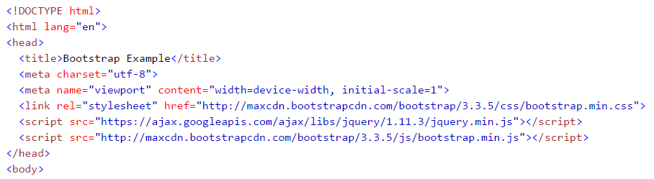
How to get Bootstrap
Download Bootstrap and host it yourself
Use Bootstrap CDN (Content Deliver Network)
MaxCDN provides CDN support for bootstrap’s CSS and JavaScript
Grid System
Basics
How

Slide 51
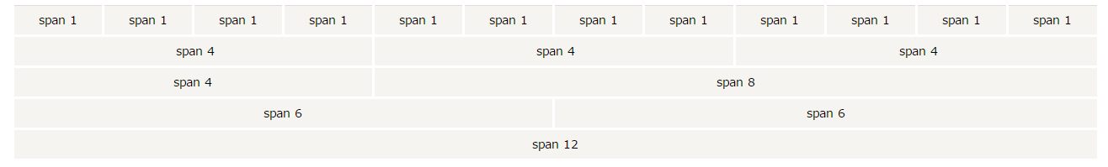
Grid System
Allows 12 columns across the page
Grid System
Basics
How
Notes:
Bootstrap's grid system allows up to 12 columns across the page.
I don’t have to use it all individually and can group the columns together to create wider columns:
Bootstrap's grid system is responsive, and the columns will re-arrange depending on the screen size: On a big screen it might look better with the content organized in three columns, but on a small screen it would be better if the content items were stacked on top of each other.

Slide 52
Grid System
.col-md-4
Grid system has four classes
xs (for phones)
sm (for tablets)
md (for desktops)
lg (for larger desktops)
Grid System
Basics
How
Notes:
Use the classes to change the layout for different screen sizes

Slide 53
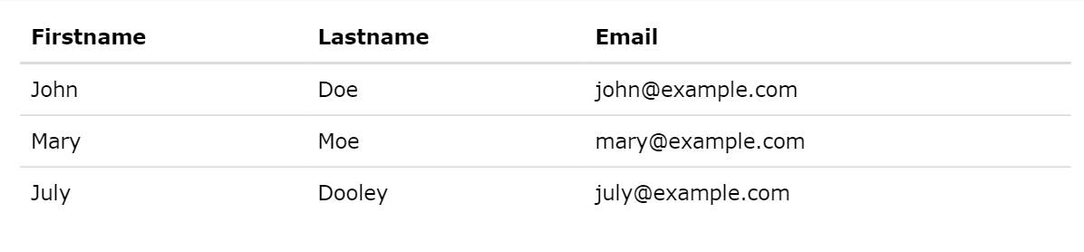
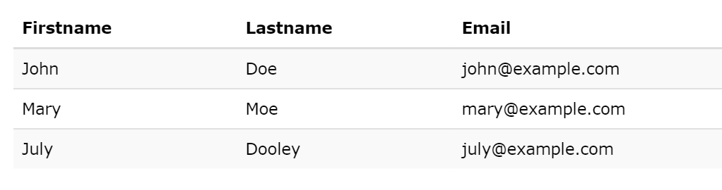
Tables
.table
.table-striped

Slide 54

Very Useful Resource

Slide 55
AJAX
Popular HTML, CSS, and JavaScript framework

Slide 56
What is AJAX?
Stands for Asynchronous JavaScript And XML
Lets you
Update web pages without reloading the page
Request / receive data from server after the page had loaded
Send data to the server in the background
Examples include: Bing Maps, Outlook.com, YouTube, Facebook
Notes:
Compare with traditional static webpages where you need to refresh the entire page to see updates

Slide 57
Next Up: Hands On Demo
Creating the client side

